Slide 1
Micro Credit Loan Use Case

Slide 2
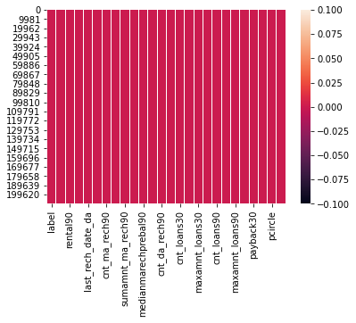
Heat map showing there are no null values in the dataset

Slide 3
Data Visualization
Various visualization techniques were used to drive out valuable information from the dataset
Use of count plot , pie chart, histogram, distplot, was done to carve out the valuable information from the dataset

Slide 4
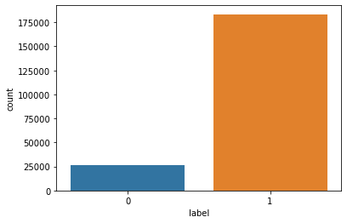
Label =Flag indicating whether the user paid back the credit amount within 5 days of issuing the loan{1:success, 0:failure}

Slide 5
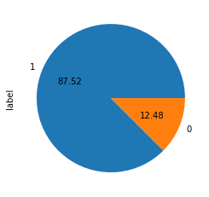
Percent of people- 1- who were able to payback within 5 days of issuing loan 0- who were not who were able to payback within 5 days of issuing loan

Slide 6
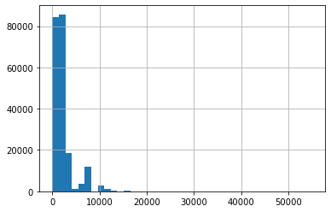
last_rech_amt_ma=Amount of last recharge of main account (in Indonesian Rupiah) observation- 1- max people have amount of last recharge of main account (in Indonesian Rupiah) between 0-1000 days approx. 2- min people have amount of last recharge of main account (in Indonesian Rupiah) beyond 10,000 days

Slide 7
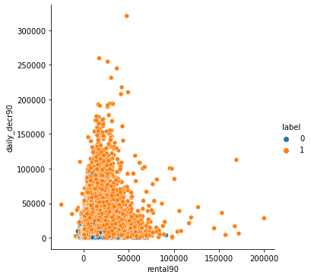
rental90= average main account balance over last 90 days daily_decr90= daily amount spent from main account, averaged over last 90 days (in Indonesian Rupiah) observation- 1-most of the people have their avg main account balance over last 90 days between 0-50,000 and their daily amount spent from main account, averaged over last 90 days (in Indonesian Rupiah) was also between 0-50000 2-very few peoplwe had their avg main account balance between 1lakh-2lakh and their spending was around 50000 3-a few cases were also there whose rantal 90 was around 60,000 and daily_decr90 was more than 3lakh

Slide 8
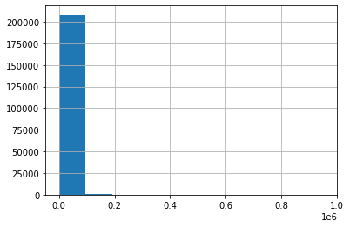
sumamnt_ma_rech90=Total amount of recharge in main account over last 90 days (in Indonesian Rupiah) observation- 1-most of the people have done recharge in main account ,over last 90 days (in Indonesian Rupiah), of amount between (0.0-0.1)(le6) (0-100000 in Indonesian Rupiah). 2-very few people have done recharge of amount between (100000-19000 Indonesian Rupiah )

Slide 9
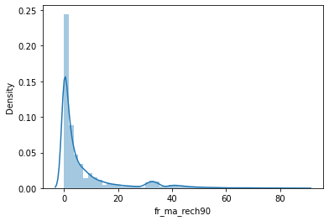
fr_ma_rech90=Frequency of main account recharged in last 90 days observation- highest Frequency of main account recharged in last 90 days - is between 0-5 days

Slide 10
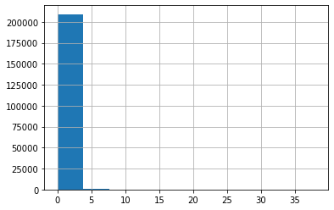
cnt_da_rech90=Number of times data account got recharged in last 90 days observation- Number of times data account got recharged in last 90 days a-0-3 times mostly b-beyond 3 times very less

Slide 11
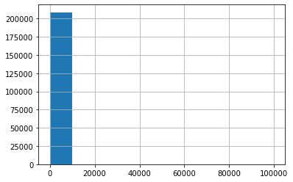
cnt_da_rech30=Number of times data account got recharged in last 30 days observation- Every data account got recharged between 0-10000 times in last 30 days

Slide 12
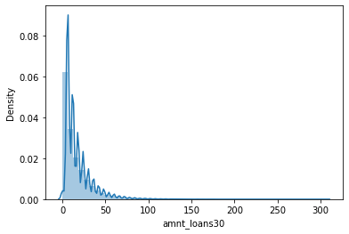
amnt_loans30-Total amount of loans taken by user in last 30 days observation- Total amount of loans taken by user in last 30 days- a-max- between 0-10 times b-min- beyond 100

Slide 13

amnt_loans90-Total amount of loans taken by user in last 90 days observation- Total amount of loans taken by user in last 90 days- a-max- between 0-10 times b-min- beyond 100

Slide 14
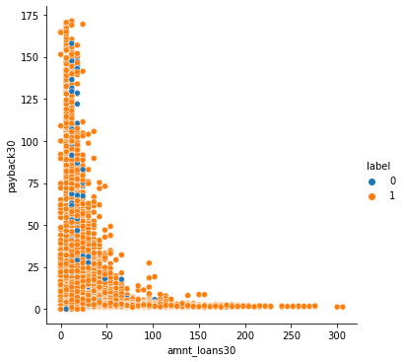
payback30=Average payback time in days over last 30 days observation- most of the people low total amount of loan(0-50loans) were having average payback time of(0-50 days)

Slide 15
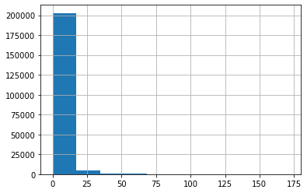
payback30=Average payback time in days over last 30 days observation- most of the people had avg payback time of 0-15days

Slide 16
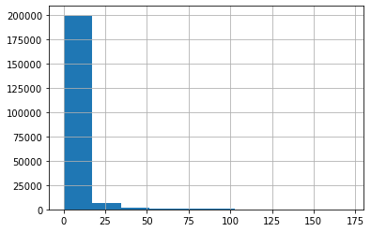
payback90=Average payback time in days over last 90 days observation- most of the people had avg payback time of 0-15days

Slide 17
Thank you
Submitted by- Akashdeep Singh Manral
Batch no- 1834

